Slide 1
Underwater Vectored- Thrust Propulsion System

Slide 2
Introduction
P A R T 0 1
Overview and Mechanical Design

Slide 3
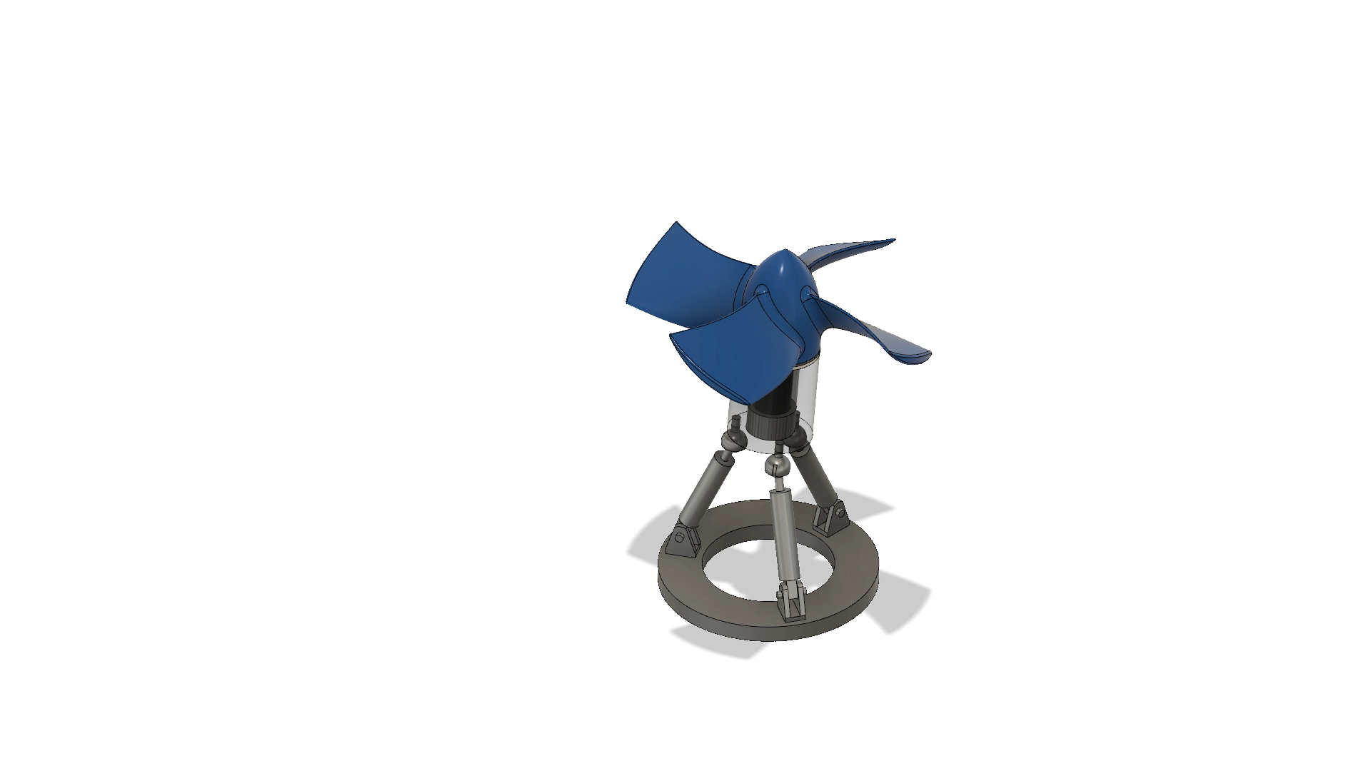
P A R T 0 1
Exploded View of a Vectored-Thrust Propulsion System

Slide 4
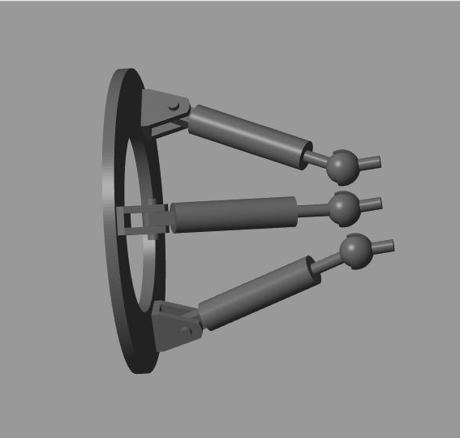
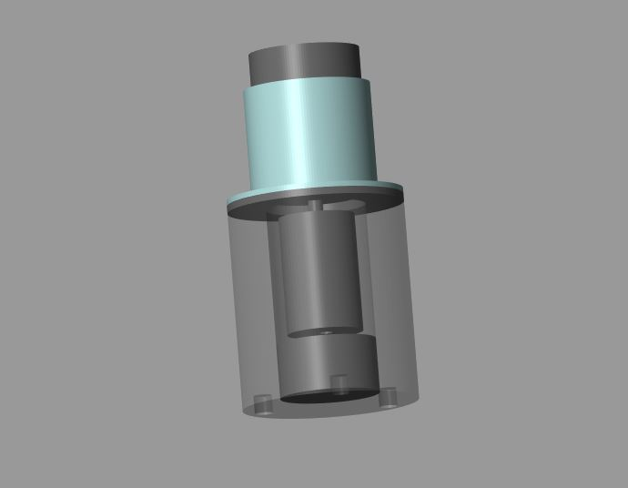
P A R T 0 1
Prismatic Actuator
Bush
Bearing
Base Plate
Containment Shroud
Motor Shaft
Inner Rotor
Motor Body
Ball & Socket Joint
Motor Driver
Revolute Joint
Motor Casing
A 3 RPS Manipulator
Motor Assembly

Slide 5
Thruster
P A R T 0 2
MATLAB - Simscape Multibody

Slide 6
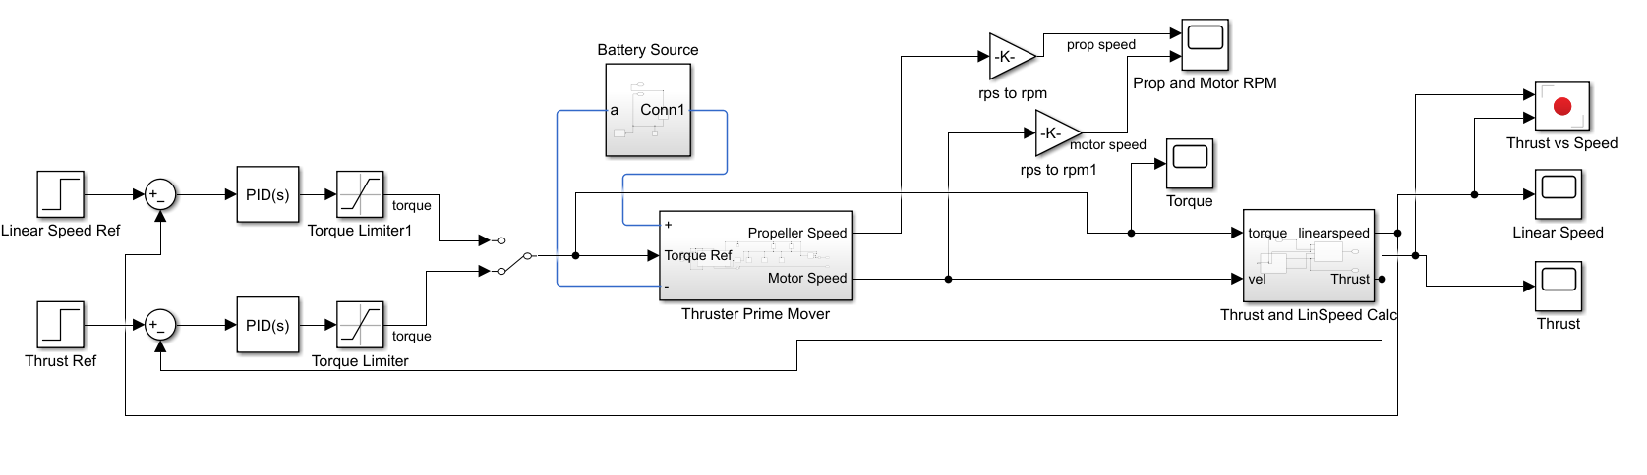
P A R T 0 2
Thrust & Linear Speed Control

Slide 7
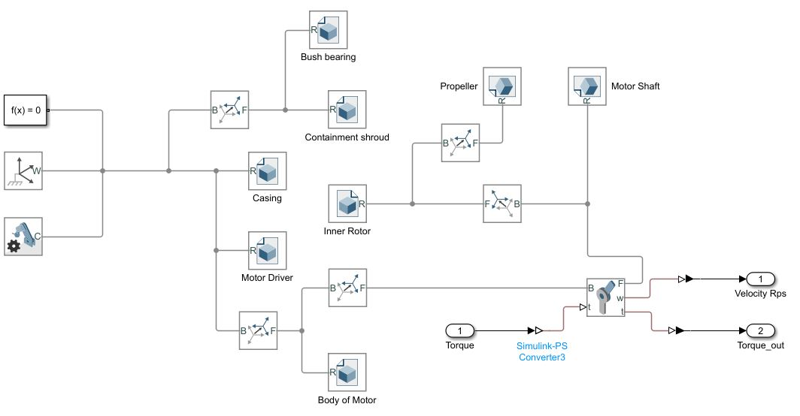
P A R T 0 2
Thruster - Multibody
*RPM of the motor saturates as torque becomes constant.

Slide 8
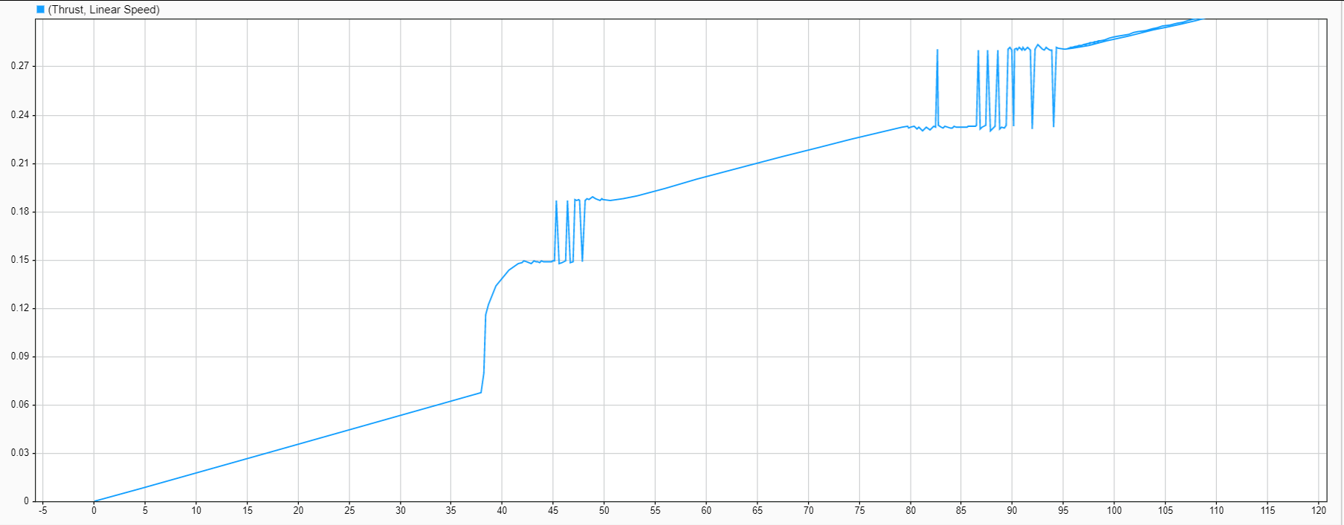
P A R T 0 2
Thrust Control Plots
Linear Speed vs Thrust Generated (Multibody)

Slide 9
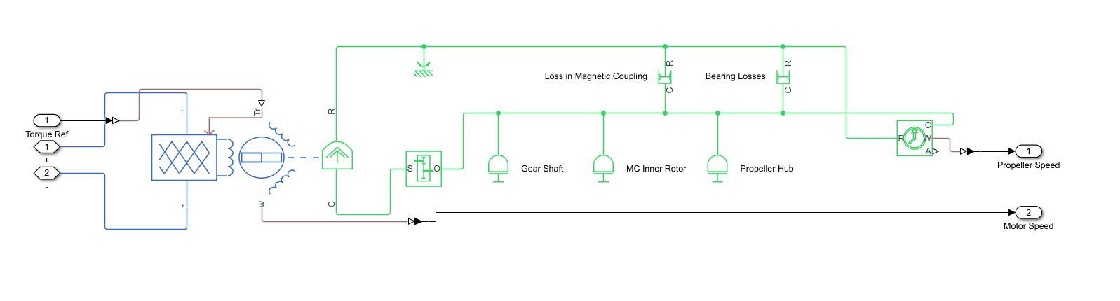
P A R T 0 2
Thruster - Simscape
Thruster Model

Slide 10
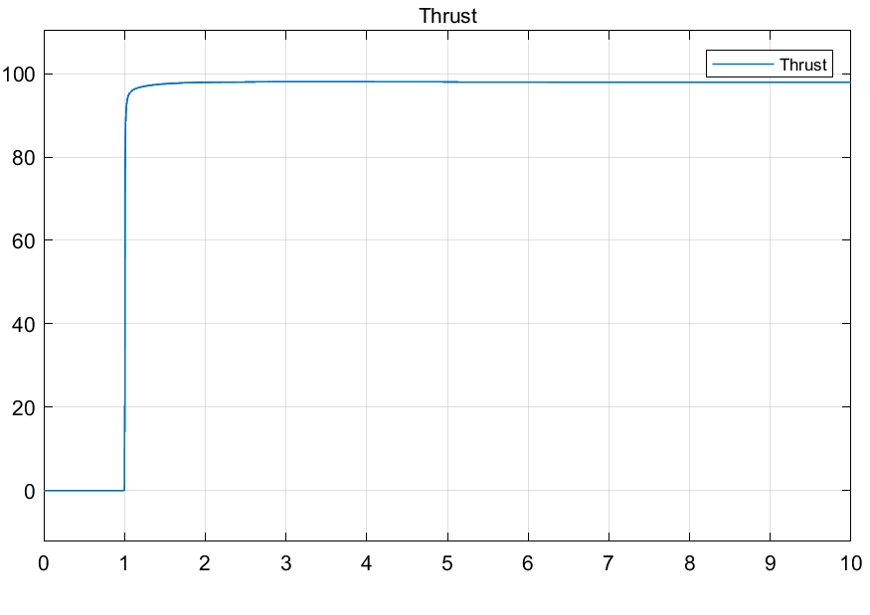
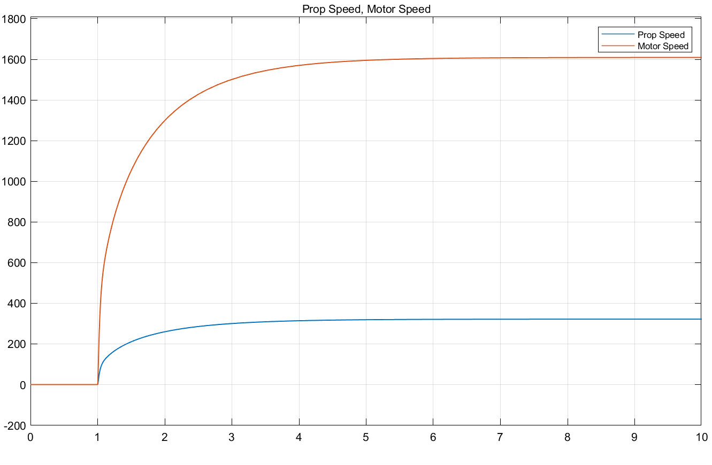
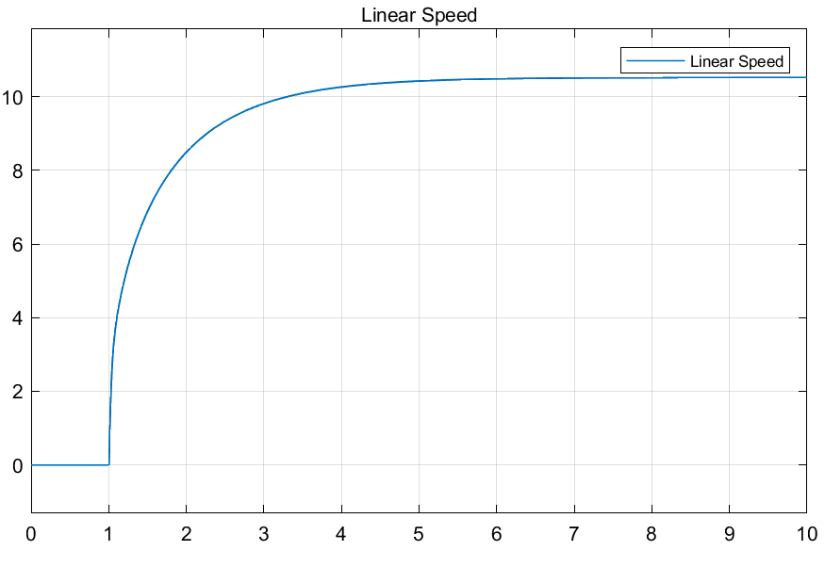
P A R T 0 2
Thrust Control Plots
Propeller Speed & Motor Speed : With Gear Box

Slide 11
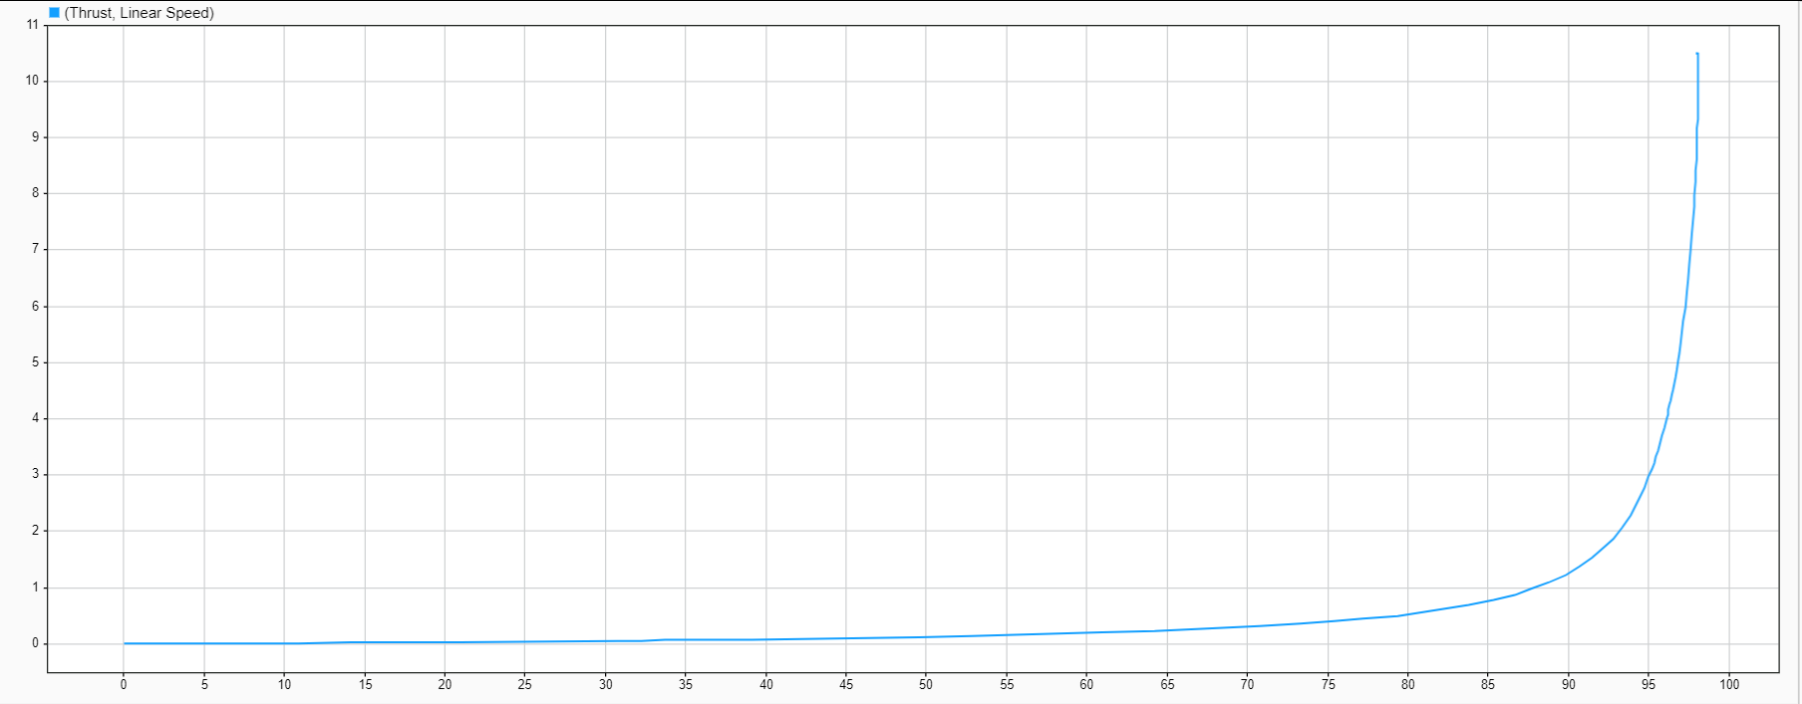
P A R T 0 2
Thrust Control Plots
Linear Speed vs Thrust Generated (Simscape)

Slide 12
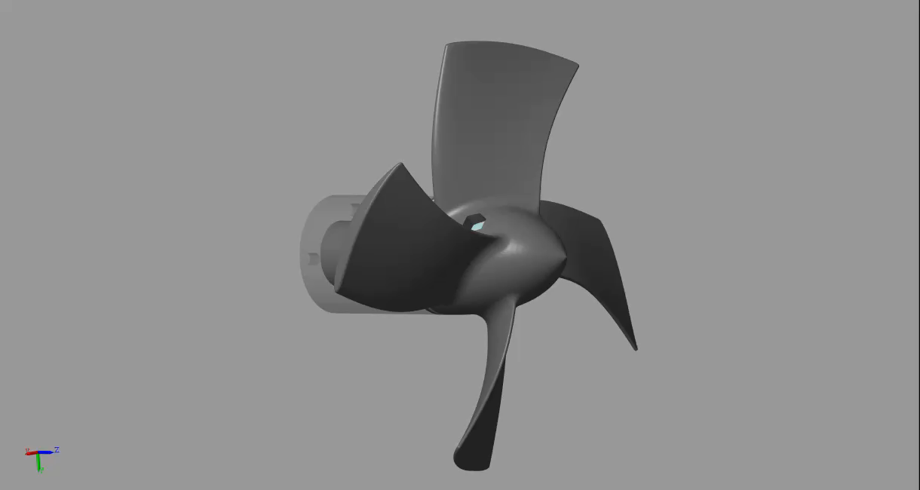
P A R T 0 2
Target: Thrust 10Kgf

Slide 13
Thrust Vectoring
P A R T 0 3
MATLAB - Simscape Multibody

Slide 14
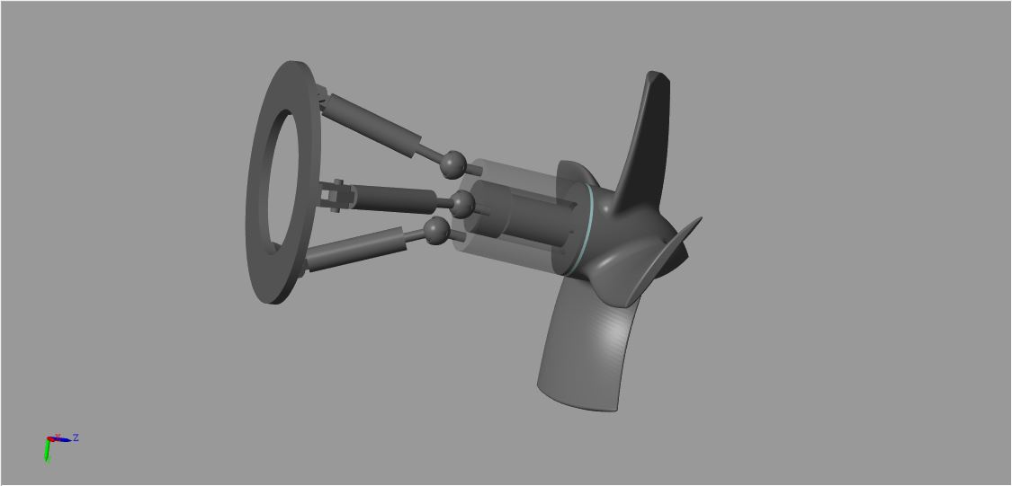
P A R T 0 3
A combined 3 RPS Thrust Vectoring Model.

Slide 15
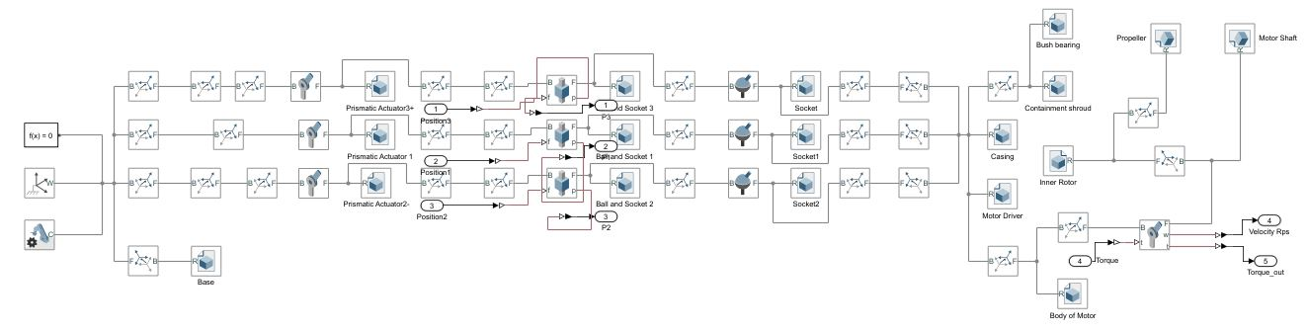
P A R T 0 3
Simscape Multibody - Vectored Thruster Model

Slide 16
P A R T 0 3
3 RPS Manipulator - Inverse Kinematics
function [l1,l2,l3] = fcn(R,r,cz,beta,theta)
alpha=atan((sind(beta)*sind(theta))/(cosd(beta)+cosd(theta)));
a=cosd(alpha)*cosd(beta);
b=cosd(alpha)*sind(beta)*sind(theta)-sind(alpha)*cosd(theta);
c=cosd(alpha)*sind(beta)*cosd(theta)+sind(alpha)*sind(theta);
d=sind(alpha)*cosd(beta);
e=sind(alpha)*sind(beta)*sind(theta)+cosd(alpha)*cosd(theta);
f=sind(alpha)*sind(beta)*cosd(theta)-cosd(alpha)*sind(theta);
g=-sind(beta);
h=cosd(beta)*sind(theta);
i=cosd(beta)*cosd(theta);
Rot=[a,b,c;d,e,f;g,h,i];
B1c=[r;0;0];
B2c=[-r/2;(-r*1.732)/2;0];
B3c=[-r/2;(r*1.732)/2;0];
A1=[R;0;0];
A2=[-R/2;(-R*1.732)/2;0];
A3=[-R/2;(R*1.732)/2;0];
cx=((-r/2))*(cosd(alpha)*cosd(theta)-(sind(alpha)*sind(beta)*sind(theta))-(cosd(beta)*cosd(theta)));
cy=-r*sind(alpha)*cosd(beta) ;
c=[cx;cy;cz];
B1=Rot*B1c + c;
B2=Rot*B2c + c;
B3=Rot*B3c + c;
l1=norm(B1-A1)-0.131;
l2=norm(B2-A2)-0.131;
l3=norm(B3-A3)-0.131;
end

Slide 17
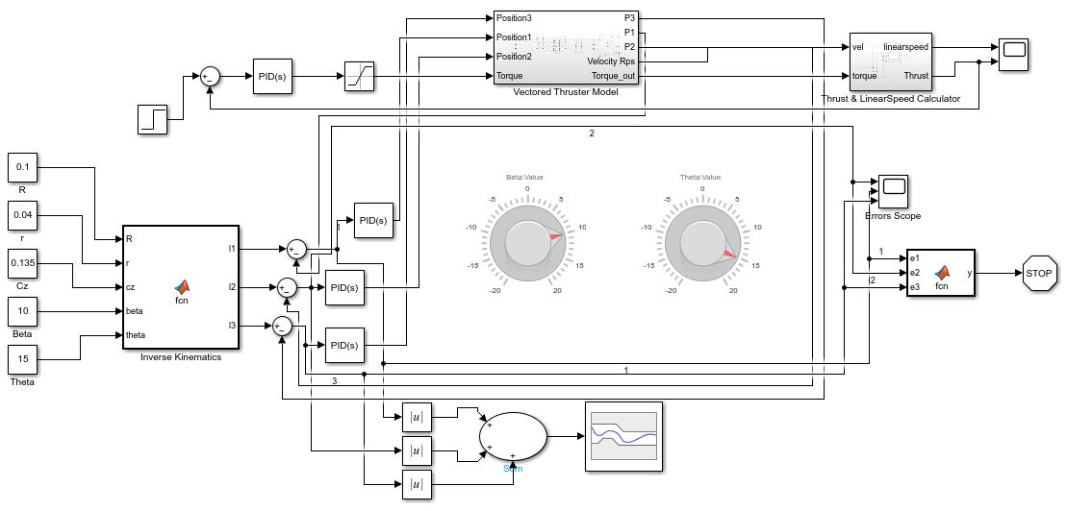
P A R T 0 3
Thrust Vectoring Model

Slide 18
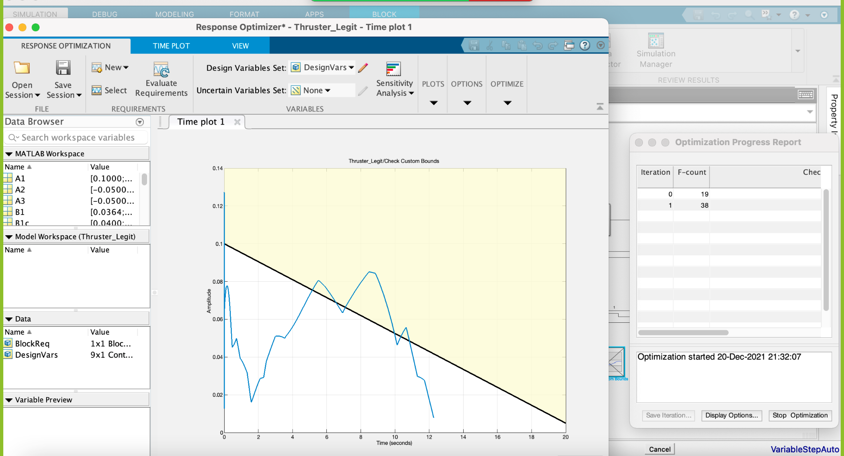
P A R T 0 3
Simulink Design Optimization Toolbox
*Optimizer response for 2 iterations.

Slide 19
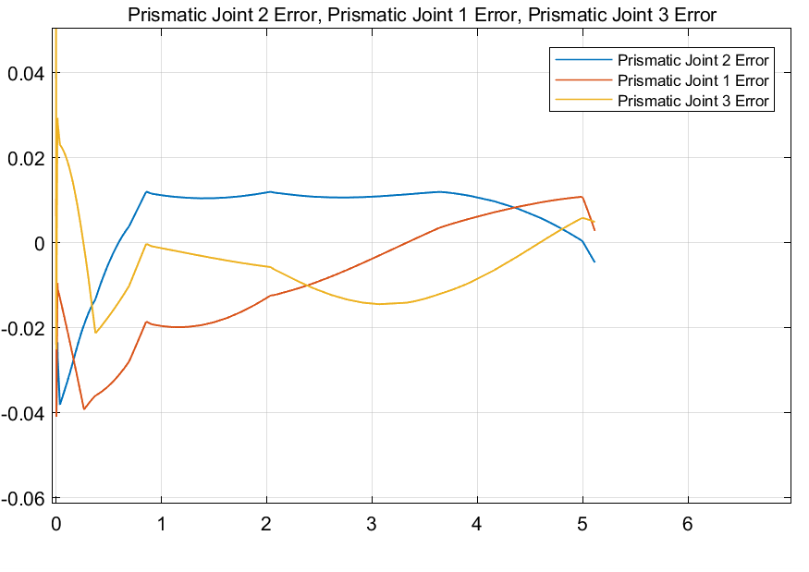
P A R T 0 3
Thrust Vectoring Model
PID Error Signals for Linear Actuation

Slide 20
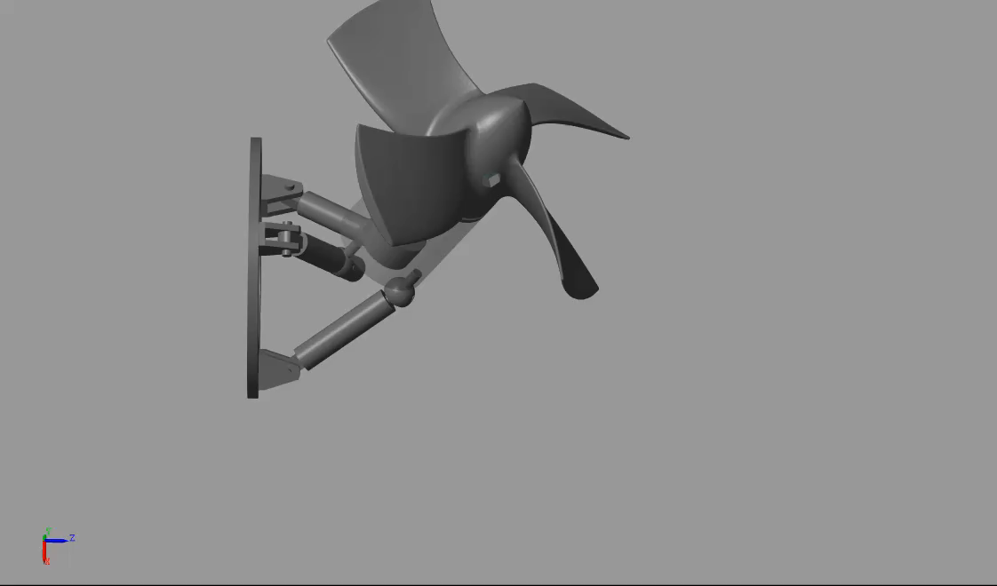
P A R T 0 3
Target: Pitch 10°(beta) & Yaw 15°(theta)

Slide 21
Findings & Conclusion
P A R T 0 4

Slide 22
P A R T 0 4
Simscape revolute joint motors have different characteristics from a BLDC motor.
Inverse kinematics was developed to accurately achieve the pitch and yaw orientation of the thruster assembly.
A control method was devised for the Thrust Vectoring Model.
Given the desired system response, the design optimizer can compute accurate values for unknown design parameters, for example - simultaneously calculating PID gains (Kp,Ki,Kd) for all actuators.

